Slide 1

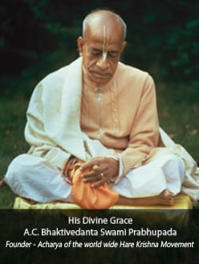

Hare Krishna, welcome please sign up to chant and hear the holy name, Haribol!
Continue with Google

Slide 2
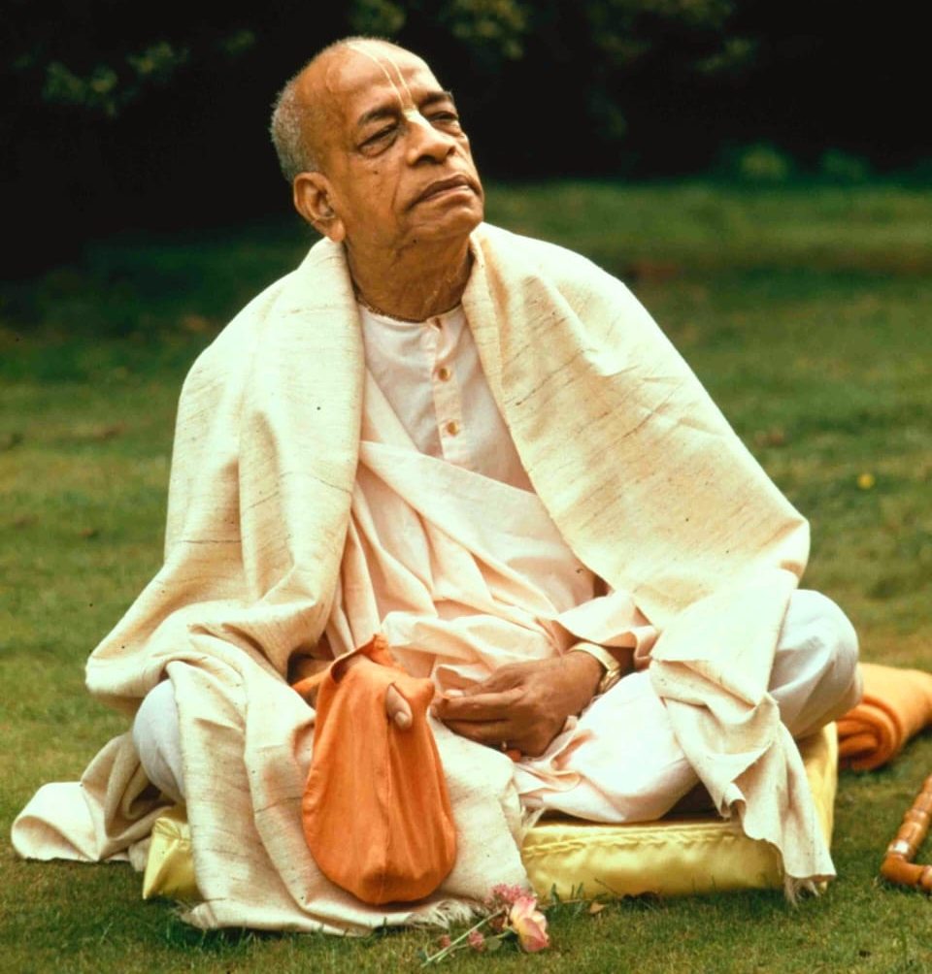
His Divine Grace
A.C.Bhaktivedanta Swami Prabhupada
Founder - Acharya of the world wide Hare Krishna Movement
Hare Krishna, welcome please sign up to chant and hear the holy name, Haribol!
Continue with Google

Slide 3
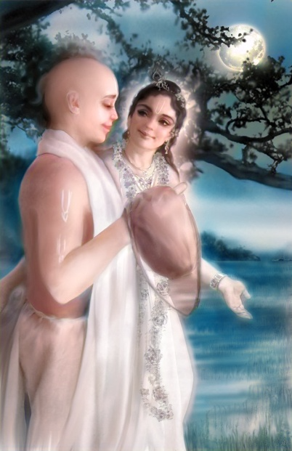

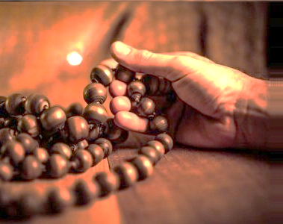
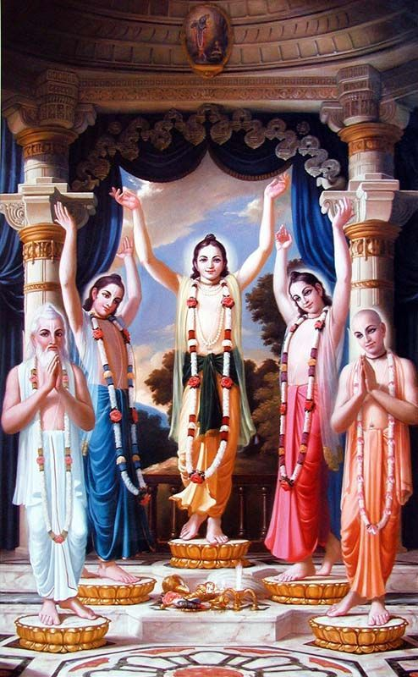



Mindful Japa
Heartful Japa
Soulful Japa
His Divine Grace
A.C.Bhaktivedanta Swami Prabhupada
Founder - Acharya of the world wide Hare Krishna Movement

Slide 4

01
Heard
67
Time take
06:18 min
02
Heard
45
Time take
07:38 min
03
Heard
78
Time take
05:45 min
04
Heard
35
Time take
08:05 min
05
Heard
90
Time take
05:56 min
06
Heard
78
Time take
06:23 min

